Slide 1



Unit 12
A vacation abroad
Language Focus

Slide 2
I- Past progressive tense
Ba was taking a shower at 8 o’clock last night
Hoa was eating dinner at that time
Past progressive tense
Form: S + WAS / WERE + V-ING…
Use: Diễn tả hành động xảy ra tại một thời điểm xác định rõ ràng trong quá khứ, thường có một số dấu hiệu nhận biết trong câu như: at…yesterday/last…, from…to…, between….and…

Slide 3
Unit 12: A vacation abroad
Language focus
I- Past progressive
The Le family was sleeping when the mailman came.
Form: S + was/ were + V-ing
when Past simple
Past progressive
II- Past progressive with when and while
The mailman came while the Le family was sleeping
Past simple
while Past progressive
Use: Diễn tả một hành động đang xảy ra trong quá khứ thì có hành động khác xen vào (khi đang…thì…)
Ngoài ra, “while” còn được sử dụng diễn tả 2 hay nhiều hành động xảy ra cùng lúc trong quá khứ.
Ex: Our father was watching TV while we were playing chess

Slide 4
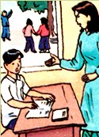
Unit 12: A vacation abroad
Language focus
I- Past progressive
Form: S + was/ were + V-ing
II- Past progressive with when and while
While + past progressive
When + simple past
Bao/forget/ homework
Bao is forgetting his homework.
III- Present progressive with always
Present progressive.
Bao is always forgetting his homework.
Form: S + is/ am/ are+ always + V-ing…
Use: diễn tả lời than phiền

Slide 5
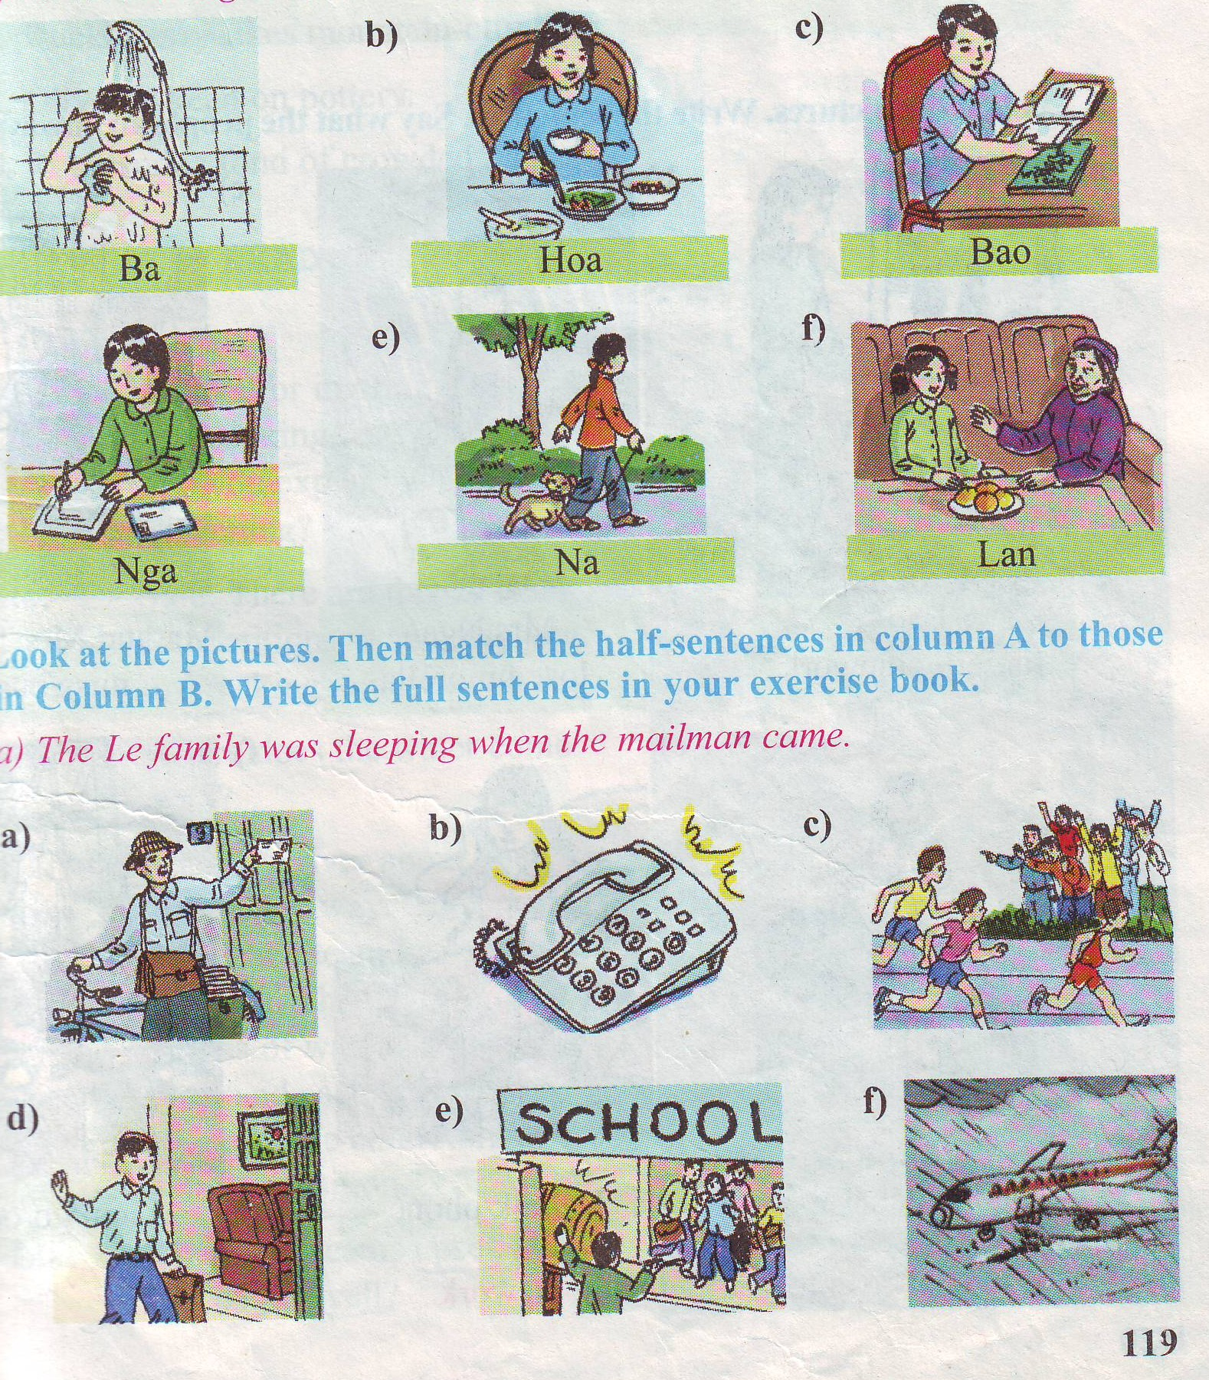
Exercise 1:
Look at the pictures. Say what each person was doing at 8 o’clock last night.
a)
Ba was taking a shower
Hoa was eating dinner
Bao was reading a comic
d)
Nga was writing a letter
Na was walking with her dog
Lan was talking with her grandmother

Slide 6
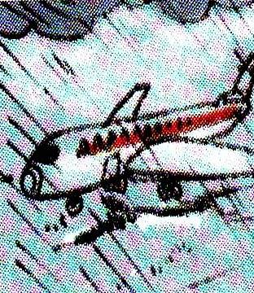
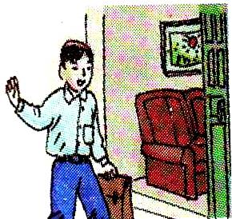
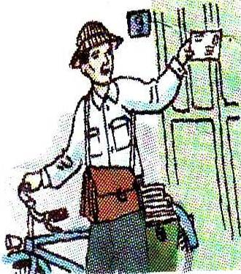

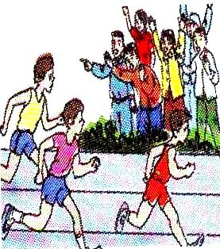
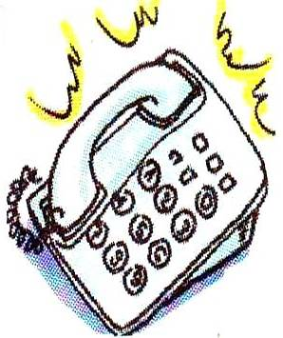
Matching
Exercise 2
The Le family
was sleeping
when the plane got
to Ha Noi
2. While Hoa was eating ,
B. when Tuan arrived
home
When Nam won
the race,
C. when the mailman
came
Mrs Thoa was
cooking.
D. the school drum
was sounding
5. When Lan arrived at
school,
E. the crowd was
cheering
6 .It was raining
F. the phone rang.

Slide 7
KEY
1-C:
The Le family was sleeping when the mailman came
2-F:
While Hoa was eating , the phone rang
3-E :
When Nam won the race, the crowd was cheering.
4-B:
Mrs Thoa was cooking when Tuan arrived home.
5-D:
When Lan arrived at school, the school drum was sounding.
6-A:
It was raining when the plane got to Ha Noi.

Slide 8
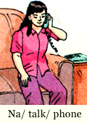
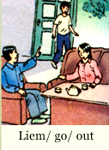
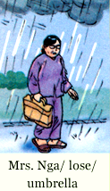
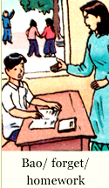
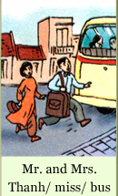
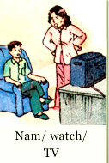
Exercise 3
Look at the pictures. Write the sentences. Say what the people are always doing

Slide 9
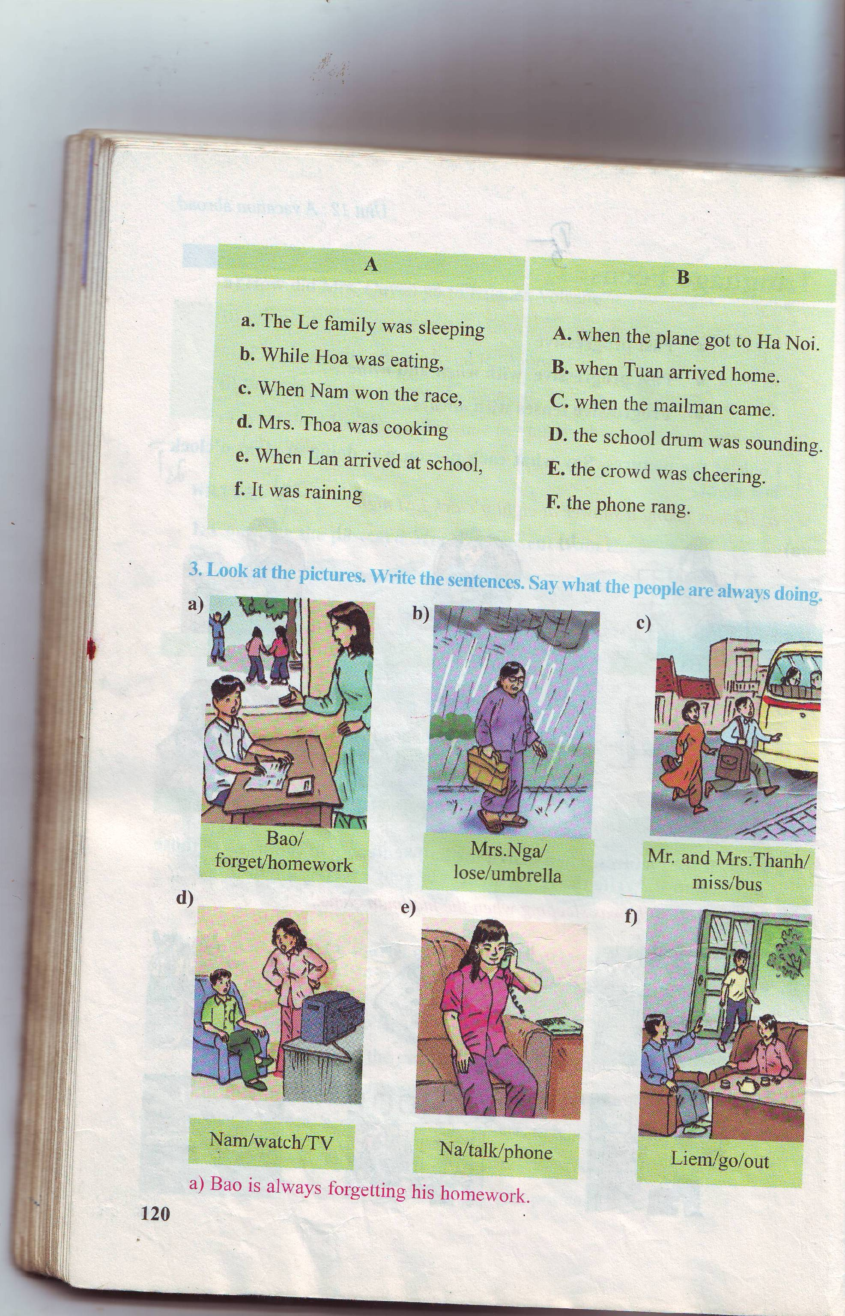
Bao/ forget/ homework
Mrs.Nga/lose/umbrella
Mr. and Mrs.Thanh/miss/bus
Bao is always forgetting his homework
Mrs Nga is always losing her umbrella
Mr and Mrs Thanh are always missing bus
Nam/watch/TV
Na/ talk/phone
Liem/go/ out
Nam is always watching TV
Na is always talking on the phone
Liem is always going out

Slide 10

Excercise: Choose the best answer.
1. The family………..when the mailman came.
A. is sleeping B. was sleeping C. has slept D. have slept
2. .............I was doing homework, my friend came
A. when B. at which C. while D. at time
3. I was reading..............My sister was playing with her dolls
A. when B. while C. how D. what
4. Nga ………… a letter at 8 o’clock last night.
A. write B. was writing C. is writing D. writes
5. We were sleeping when the telephone…………..
A. rings B. ringing C. rang D. ring
6. When I arrived at school, the school drum .........……
A. was soundingB. is sounding C. are sounding D. were sounding
7. Mrs Nga………….always ………….her umbrella
A. was/ losing B. has/ lost C. will/ lose D. is/ losing
8. My father is ………. forgetting things on the bus.
A. always B. usually C. often D. sometimes

Slide 11
Unit 12: A vacation abroad
Language focus
I- Past progressive
Form: S + was/ were + V-ing
1- Learn structures by heart.
2- Review grammar and vocabulary of unit 12
3 - Prepare unit 13: Getting started – Listen and read (find vocabulary).
II- Past progressive with when and while
While + past progressive
When + simple past
III- Present progressive with always
S + is/ am/ are+ always + V-ing
III- Homework

Slide 12



THANK YOU
FOR YOUR ATTENTION !
Good bye!

